Slide 1


Theodore Judah Elementary
Returning Together for the 2020-21 Academic Year
Notes:
Principals:
This PowerPoint is a template that you can use to conduct school site meetings or to record a presentation. Please build around the content based on your site!
Thank you---SCUSD Communications

Slide 2
Parent Meeting
Introduction
Information and Resources
Timeline for Return Together
Return Together Options
Schedules for our Campus
Health and Safety
What our campus will look like.
*Recommended – Q and A
Notes:
Today we will talk about…..
(Principals, it is recommended that you end with a Q/A)

Slide 3
Introduction
Thank you for your patience and partnership throughout this last year.
We are excited to Return Together!
Families will decide how their student will participate for the rest of the year. Every family’s decision will be personal to them. We want to provide you with all the information you need to make this decision.
Considerations as we reopen:
Returning Together means working together.
As we reopen, we must be ready to change course if needed
Everyone has a part in keeping us health and safe.

Slide 4
Return Together Video SCUSD
Includes In-person Concurrent Learning
Return Together Video Link

Slide 5
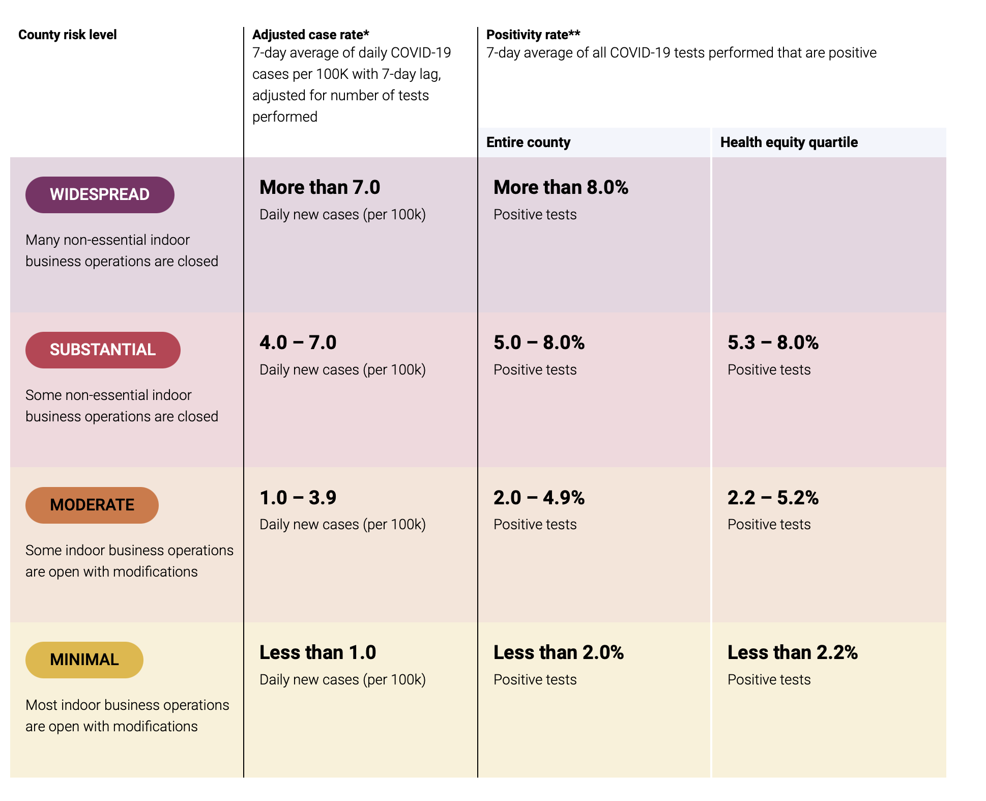
Sacramento County
Risk Levels
As of 3/5:
Purple/Widespread
< 14 cases per 100,000
Eligible to reopen K-6
SCPH Latest News
Notes:
Sacramento County is currently in the purple tier and we are seeing positive momentum that we will continue to move into lower risk tier levels.
Right now we are eligible to reopen K-6 and as we move into the red tier this will expand our reopening eligibility
But it is going to take all of us to maintain this momentum - this is why we must continue to be vigilant and follow health and safety protocols.
Wear a face covering - Practice physical distancing - Screen for symptoms - Don’t gather with people outside of your household
This is group effort and we must work together to protect each other.

Slide 6
Sacramento County
Risk Levels
Reopening in Purple Tier - Criteria for Reopening
Health and Safety Plan Must be Approved by County.
The District’s plan is the Return to Health Plan.
  Strong health and safety protocols in place
    Face Coverings
    Physical Distancing
    Hand hygiene
    Screening
We will return together to a safe school environment…
but it will look different than we are used to!
Notes:
In order to reopen, our district’s Health and Safety plan must be approved by Sacramento County Public Health. Our detailed plan is available on our website at returntogether.scusd.edu. Families can view this online, but we will also go through some of our health and safety protocols later in this presentation. What is important for you to know: Your student will be safe on our campus. We have taken every precaution necessary to ensure the safety of our students and staff.

Slide 7



Resources and Information
District Resources for you:
Information about learning models, distance learning learn.scusd.edu
Health and Safety plans, as well as resources and handouts
returntogether.scusd.edu
Preparation of campuses and staff, and COVID-19 information. reopeningdashboard.scusd.edu
Notes:
We ask you, if you can, to take a moment t o review our plans. Information we will discuss today can be found at the following places (READ BULLETS ABOVE)
As we are going through this presentation today, look out for the website at the bottom of the slide. If there you have questions or need more detail, please view the information there.

Slide 8
Timeline for Returning
The current schedule for students to begin In-Person/Concurrent Learning is:
April 8 – Return of PreK–3 students, and K-6 Special Day Classes
April 15 – Return of 4-6 grade students
If Sacramento County is in Red Tier:
  May 6 – Return of 7-12 grade students
learn.scusd.edu

Slide 9
Timeline for Returning
Additional dates:
March 5 - March 17 - Families complete a Learning Options Form.
By March 29 - Families will learn about their students cohort assignment.
March 29 - April 2 - Spring Break
April 8: First Date of Targeted return
(EK -3 and Special Day Classes)
learn.scusd.edu
Notes:
You should have received an invitation to complete a Learning Options Form. This form will tell the district whether your students will participate in the In-Person Concurrent Model orin Distance Learning.
Families will learn about cohort assignments through email and students can view their students cohort in infinite campus.

Slide 10

Return Together Options
Distance Learning - Students would remain in distance learning
In-person/Concurrent Learning – Students would attend school in-person two (2) days each week and distance learning the other three (3) days each week.
learn.scusd.edu
Notes:
Families may choose between two options for their students to return to campus
SDC students will be in-person 4 days a week

Slide 11
In-Person/Concurrent Learning
Students will be in small cohorts, or groups
No more than 50% the size of a normal class
Attend school on alternate days
Will be grouped in Group A (T, Th) and Group B (W, F)
Everyone is Distance Learning on Mondays
We will do our best to ensure household members attend on the same day, but we cannot guarantee it. Our focus is safety.
learn.scusd.edu
Notes:
In the in-person model, students will attend school in small cohorts. (READ THE SLIDE)

Slide 12
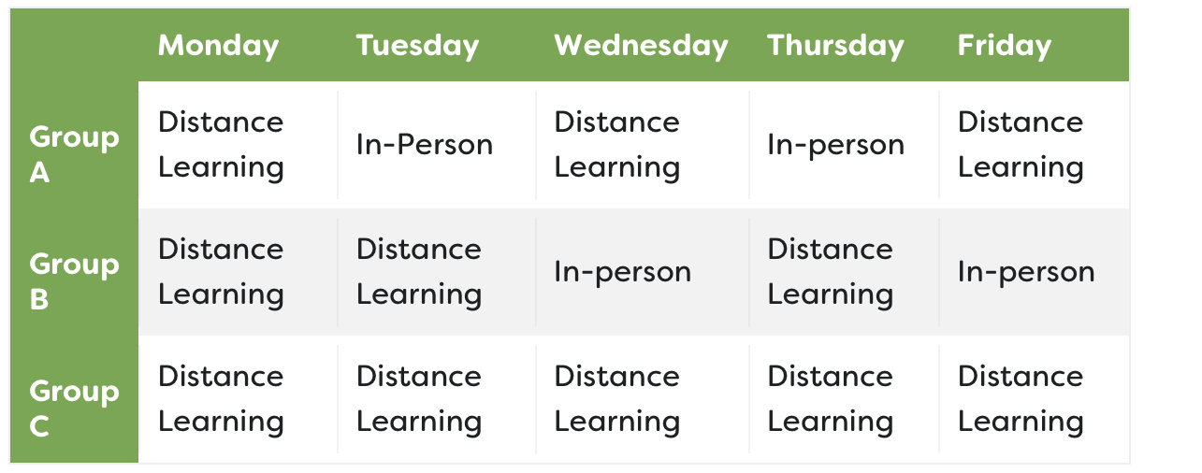
In-Person/Concurrent Learning
Elementary Schedule
learn.scusd.edu
Notes:
For elementary: Your student’s on-campus-days will depend on the cohort they are assigned to. We will have two separate cohorts: one that attends on Tuesdays and Thursdays and one that attends on Wednesday and Fridays.
All groups would participate in distance learning on Mondays.
Cohort A would learn in-person on Tuesday and Thursday.
Cohort B would learn in-person on Wednesday and Fridays.
Cohort C (Distance Learning only) would not participate in-person.

Slide 13

In-Person/Concurrent Learning
Elementary Schedule
K-6 special day class students will attend in-person Tuesday - Friday. This four-day schedule may be phased in.
learn.scusd.edu
Notes:
K-6 Students with Disabilities in Special Day Classes will attend classes in-person Tuesday – Friday.

Slide 14
In-Person/Concurrent Learning
Elementary Schedule
Learning Hubs will continue 5 days each week for students currently enrolled in the program.
Learning Hubs | In-Person | In-Person | In-Person | In-Person
learn.scusd.edu
Notes:
K-6 Students with Disabilities in Special Day Classes will attend classes in-person Tuesday – Friday.

Slide 15
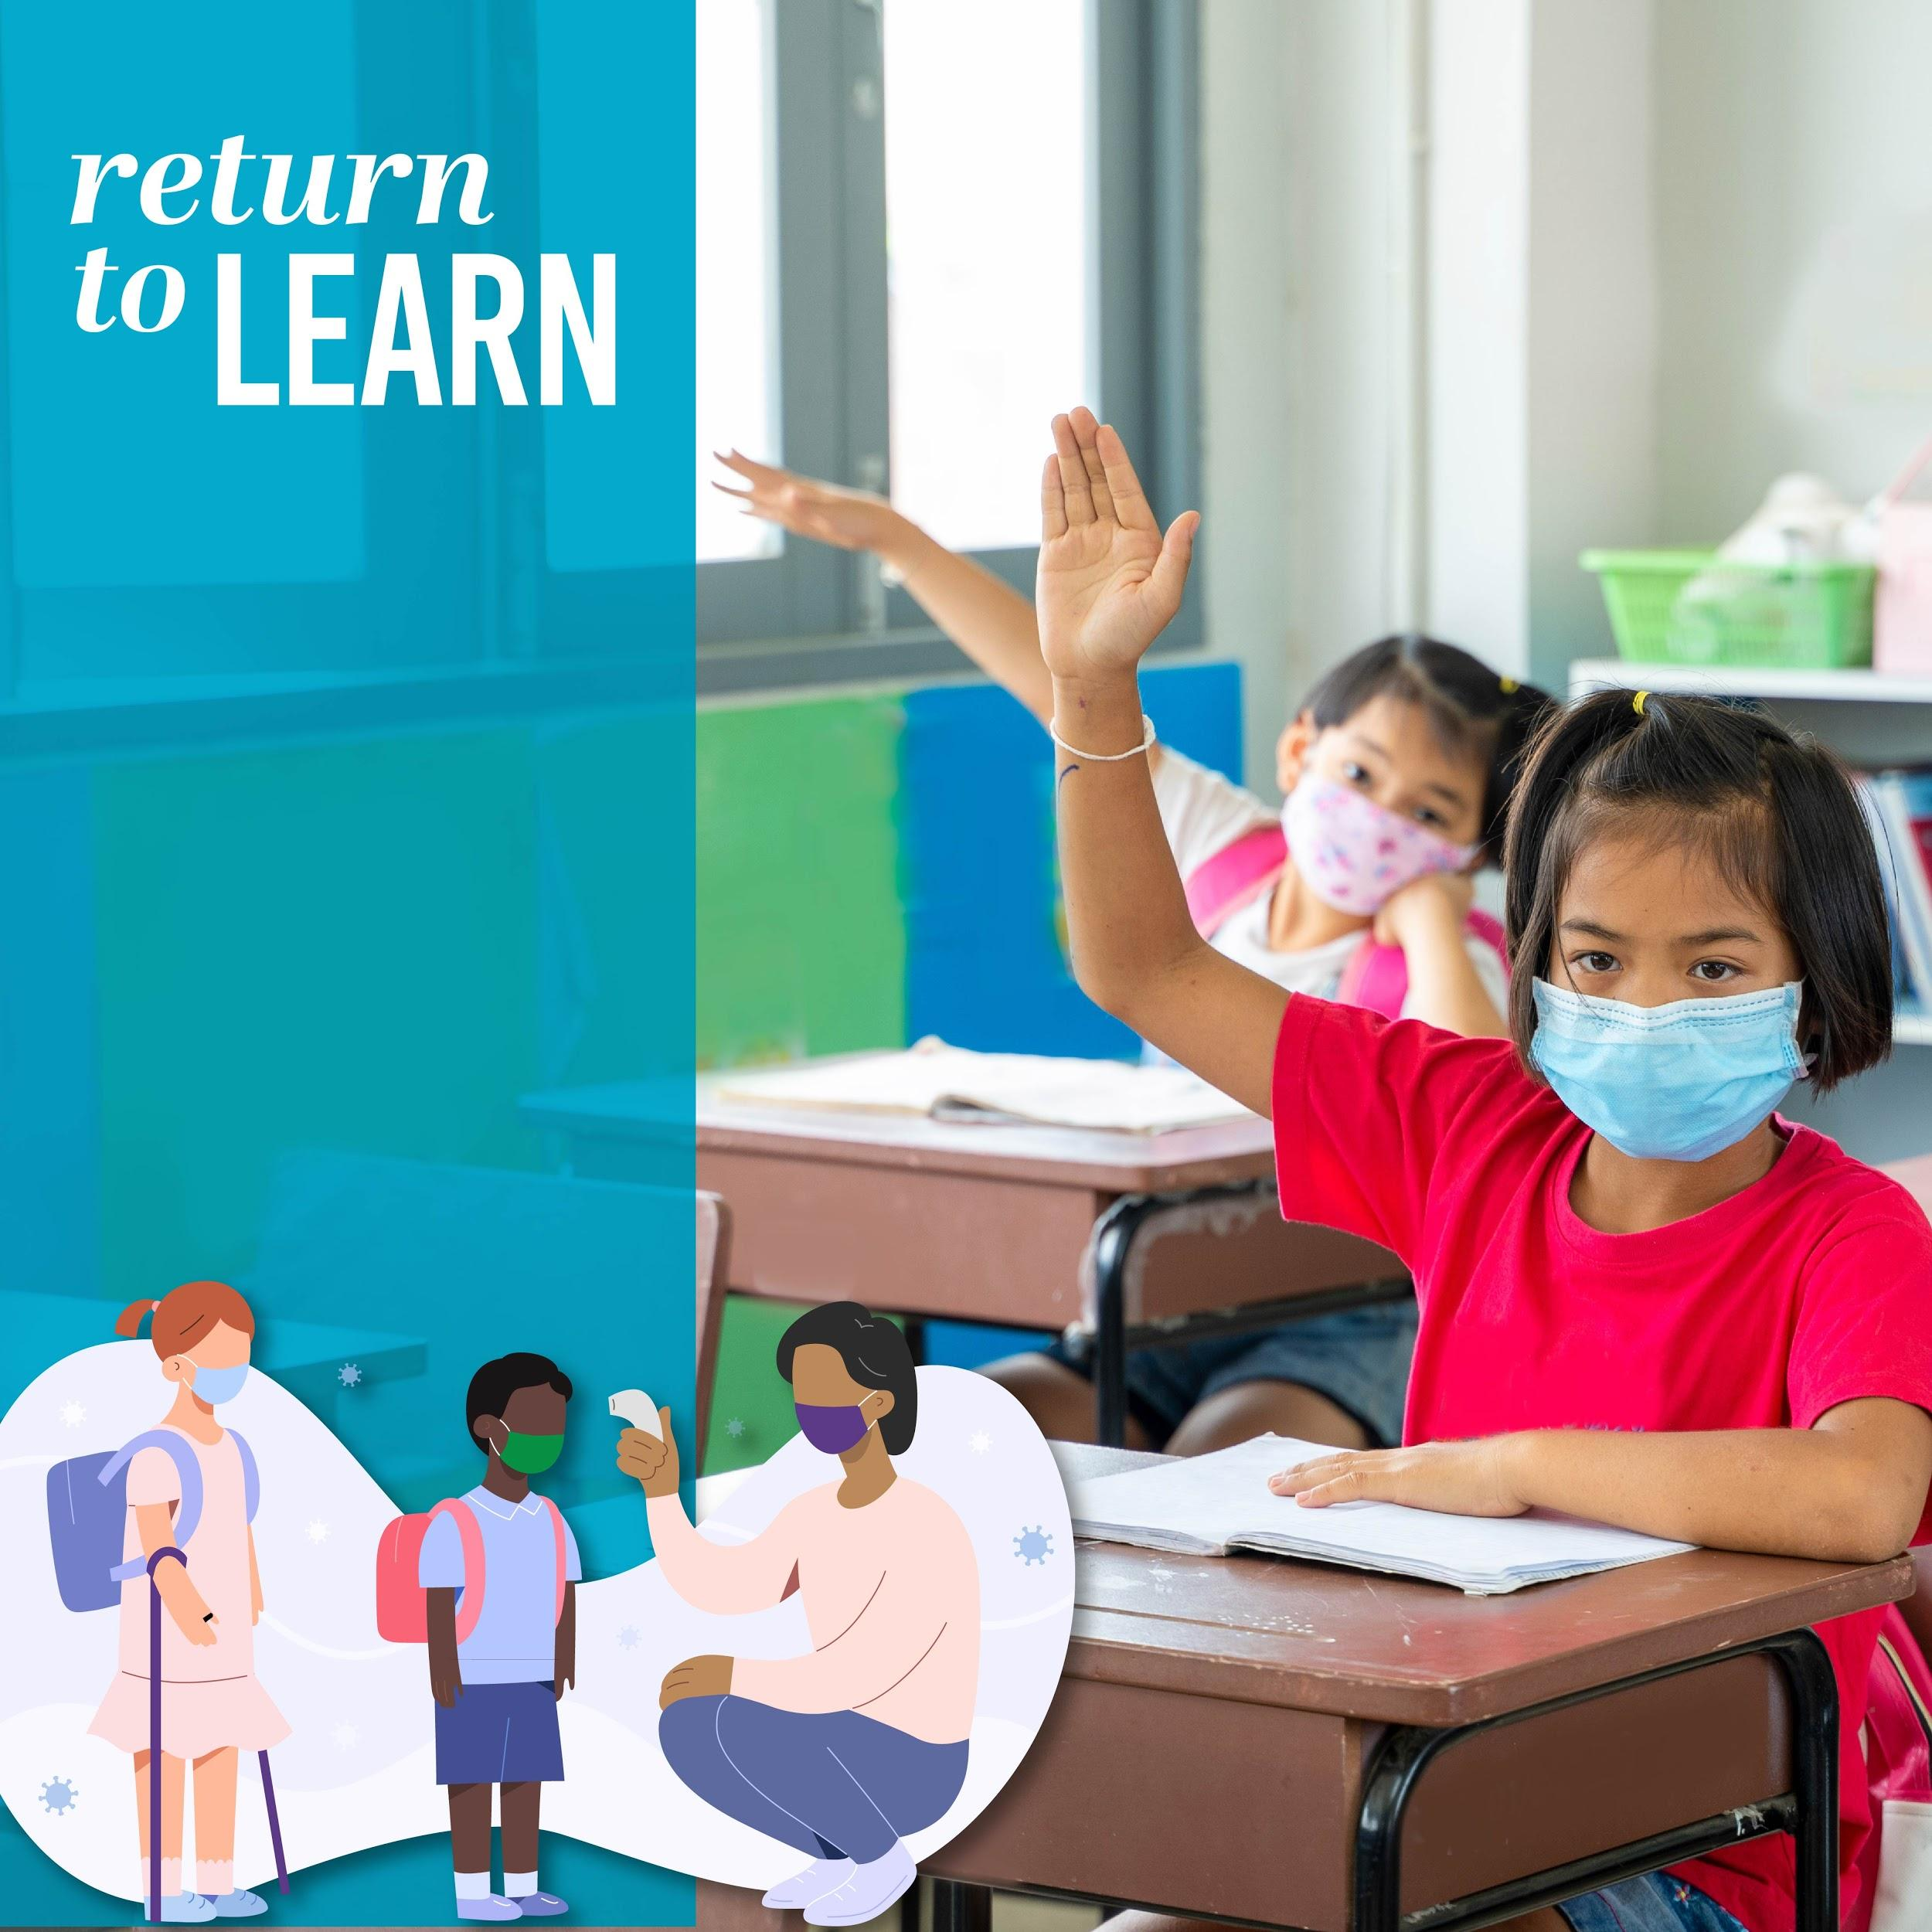
In-Person/Concurrent Learning
What is Concurrent Learning?
  Students in the classroom can participate with their classmates who are learning from home in a distance learning model.
  Students may use their computers in class and Zoom may be used to help in-person and distance learning students interact.
  Students will interact with their in-person peers as well as distance learning peers.
  Classroom activities can include paperwork, group work, interactive activities.
learn.scusd.edu

Slide 16
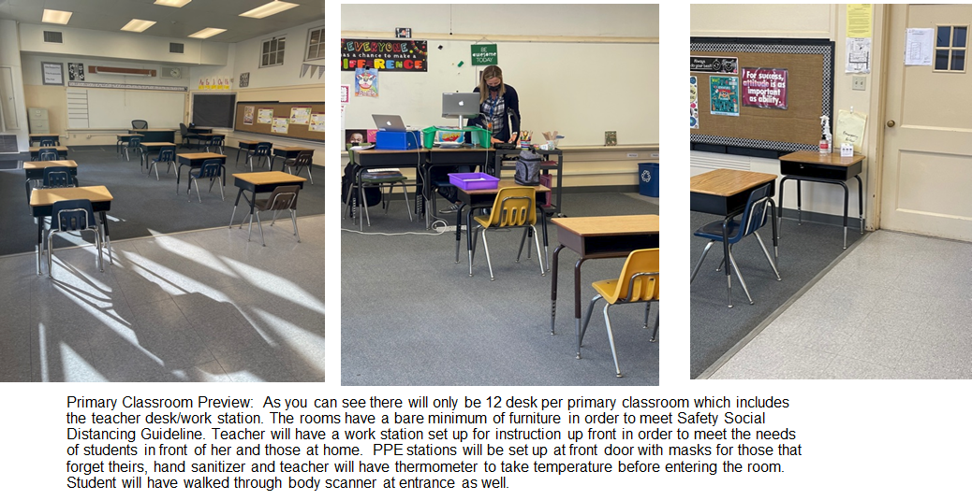

Slide 17
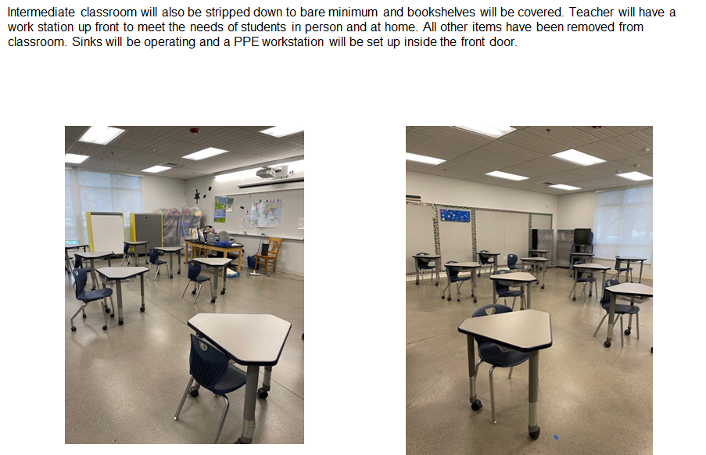

Slide 18
In-Person/Concurrent Learning
Teacher Technology
Teachers will be provided the materials and professional development they need to make classes interactive and rewarding for students - both in-person and in distance learning.
Technology materials include:
  3-in-one device with microphone, speakers, and camera (Polystudio)
  2 Computer Devices (one for work, one for video)
  A display monitor for students
  Additional chargers/electrical if needed
learn.scusd.edu

Slide 19
In-Person/Concurrent LearningExample Day (Sample)
Sample Times | At Home Students | In person students
8:00-8:30 30 min | Log in to Morning Meeting (SEL) and complete warm-up - online | Arrive on campus and complete warm-up and morning meeting (SEL)
8:30-8:40 10 min | Yoga Break - online | Yoga Break
8:40-9:20 40 min | Math Lesson or ELA - online On Zoom for digital manipulatives and breakout rooms | Math Lesson or ELA Students engage in person whole class and in small groups .
9:20-9:35 (15 min)/Grades 1-2 9:40- 9:55 (15min)/Grades 3-4 10:00- 10:15 (15min)/Grade 5-6 | RECESS | RECESS (Zones will be established for each grade level)
9:35-10:35 1 hour | Language Arts or Math - online Combination of 15-20 min online mini lessons & 15-30 min off-screen tasks | Language Arts or Math Students engage in person whole class and in small groups .
10:35-11:00 25 mins | Social science Lesson - online On Zoom and breakout rooms | Social Science Lesson Students engage in person whole class and in small groups .
11:20-12:00 40 min | LUNCH (11:20 -12:00) Lunch already provided | LUNCH (11:20-12:00) Grab a bag for today’s & tomorrow’s lunch to take home
12:00-2:00 | Asynchronous work time and small group targeted instruction
Notes:
Every class is going to look different - our teachers will design the lessons that work best for their classrooms.

Slide 20
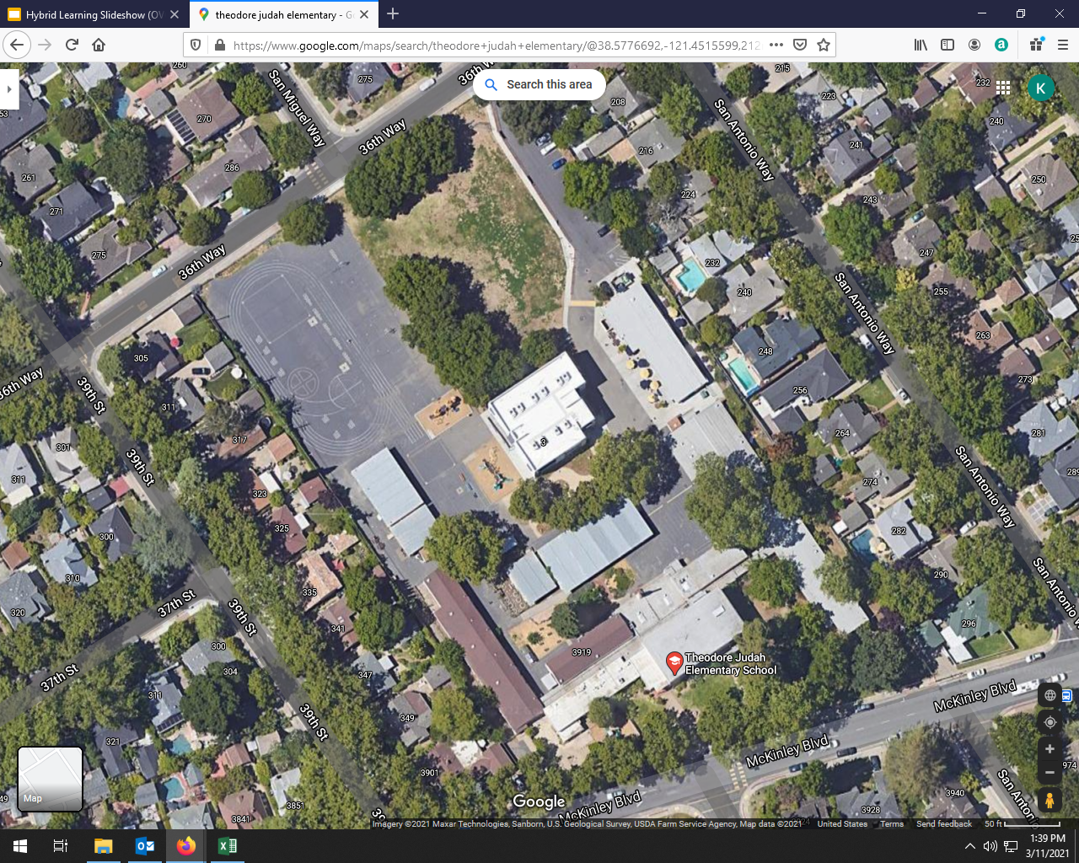
Zone 2
Zone 1
Zone 3

Slide 21
Reopening Support Needs
Additional care and support
The district will offer expanded learning after school programs at 42 sites.
School-age Children’s Center provided Mon. - Fri. from 8 a.m. - 4 p.m.
Materials and technology will be provided for students.
Students can take laptops and materials back-and-forth from school sites as needed.
learn.scusd.edu

Slide 22
Reopening Support Needs
Nutrition
Free Meals will continue to be provided each day whether students participate in on-campus learning or distance learning.
Water
Disposable drinking cups will be provided for elementary classrooms which have sinks for water.
learn.scusd.edu

Slide 23
Reopening Support Needs
What will the school do to support my student socially and emotionally?
Establish and maintain relationships through community building
Explicitly teaching SEL lessons daily to develop skills toward resilience
Maintaining safety by teaching and reinforcing predictable routines
learn.scusd.edu

Slide 24
Reopening Support Needs
What can parents/guardians do to support your students socially and emotionally?
Maintain a practice of self-care, establish routines
Stay connected with your school - SEL newsletters and Principal Communication
Support Family Connectedness and Resilience by
  Regularly checking in with your child
  Connecting through family projects, like cooking, gardening, story telling
  SEL Web Resource page for Families :https://sites.google.com/scusd.edu/sel/home/family-resources?authuser=0
Notes:
Maintain a practice of self-care in order to do family care
Establish a routine for your family and your student
- SEL practices sent via newsletters that you can reinforce at home

Slide 25
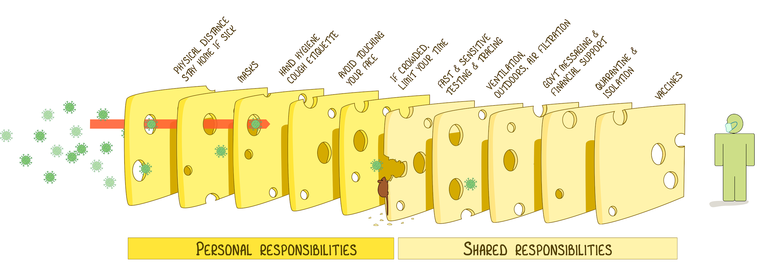
Health and Safety Information
returntogether.scusd.edu
Image by Ian McKay
Notes:
We know that there isn’t just one way to mitigate against spread of COVID. And each method of protection has its strengths and weaknesses. This chart illustrates that when we put each strategy together- such as washing hands, screening, distancing, wearing face masks, testing and vaccines - we can the most successful.
We are happy to announce that we have invited all of our staff to receive the COVD-19 vaccination, but the rest of our strategies continue to be important

Slide 26

Health and Safety Information
Health and Safety Protocols
Screening
Physical Distancing
Face coverings
Hand Hygiene
We’ve prepared our campuses and staff
to meet health and safety protocols.
Let’s talk about school will look like...
returntogether.scusd.edu
Notes:
There will be strict health and safety protocols on campus, and we’ve done much work to prepare our campuses to stop the spread of COVID-19 for the protections of our students and staff.

Slide 27
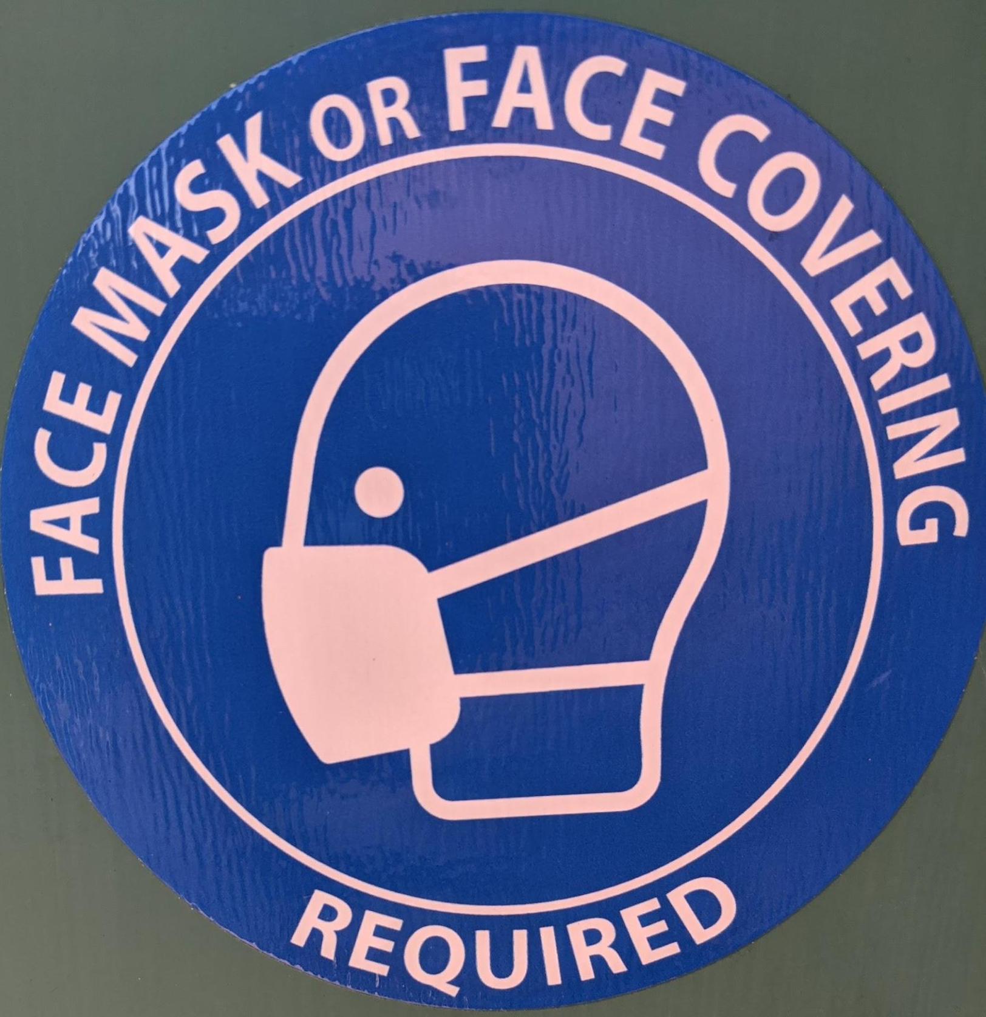
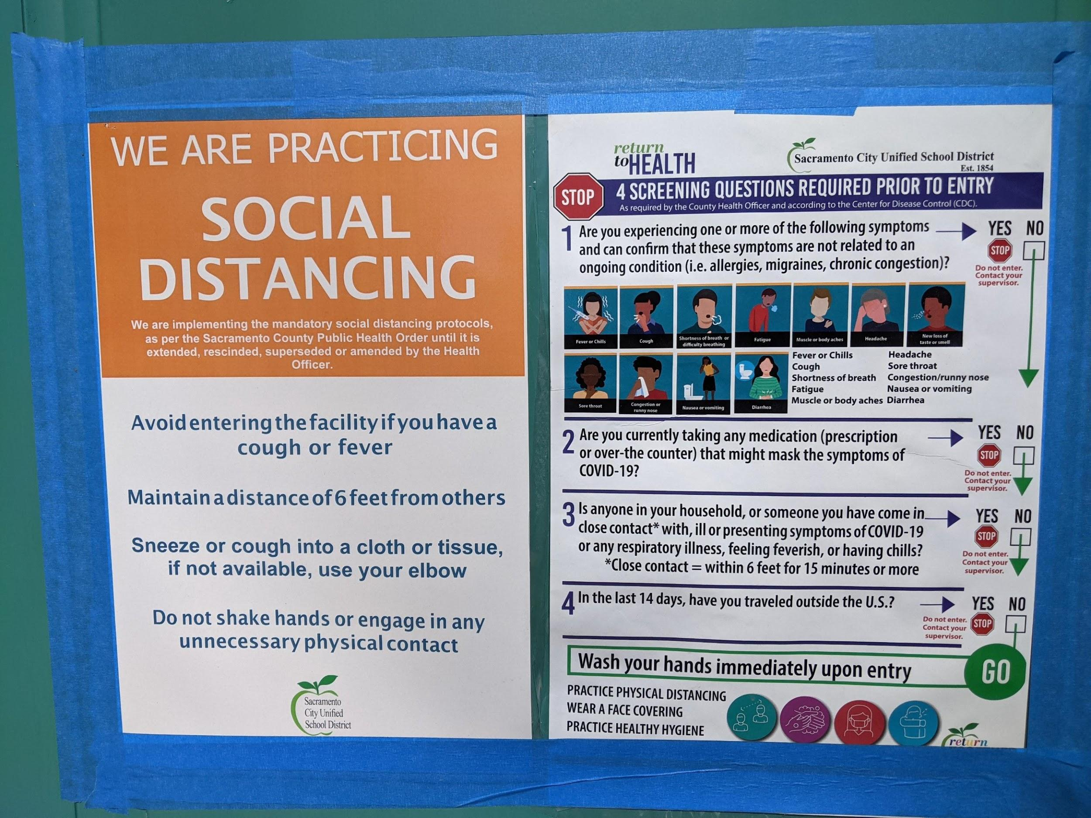
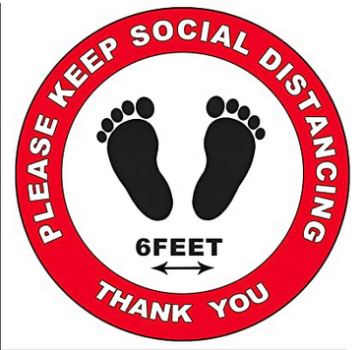
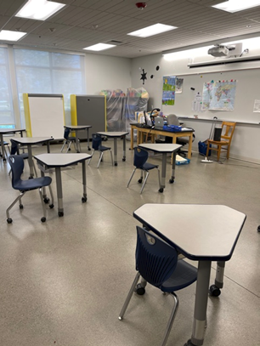
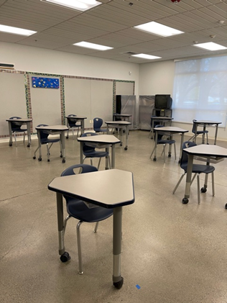
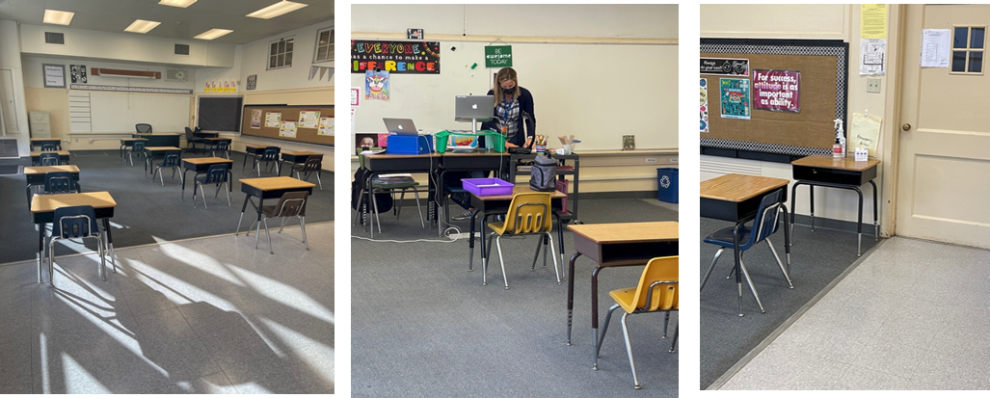

Slide 28

Health and Safety Information
Screenings
Temperature check on entry
Quick check for symptoms
Screening happens:
  At home AND
  At school
Directions at each entrance
Temperature technology
  Thermal scanners
returntogether.scusd.edu

Slide 29
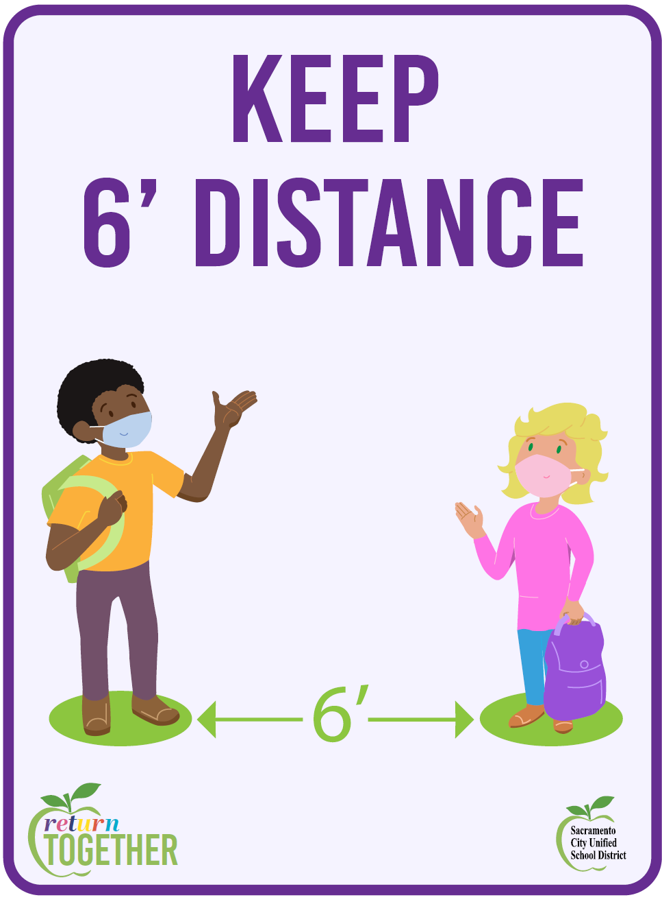
Health and Safety Information
Physical Distancing
6’ Required
Classrooms arranged to ensure spacing
Signs and reminders posted throughout campuses
returntogether.scusd.edu

Slide 30

Health and Safety Information
Face Coverings
Face coverings are required
District will provide face coverings for those who need it
Face coverings may be removed to eat or drink while maintaining physical distancing
returntogether.scusd.edu

Slide 31

Health and Safety Information
Hand Hygiene
Sanitization Stations provided
  Soap
  60% Alcohol-based Hand Sanitizer
Training on hand washing and sanitizing will be provided
Hand sanitization should occur throughout the day
returntogether.scusd.edu

Slide 32
Health and Safety Information
Site Safety and Preparation
Signage
Directional Flow of students/people
Plexiglass barriers (cafeteria, office)
Regular disinfection
Each site is assessed by a third-party before reopening.
returntogether.scusd.edu

Slide 33
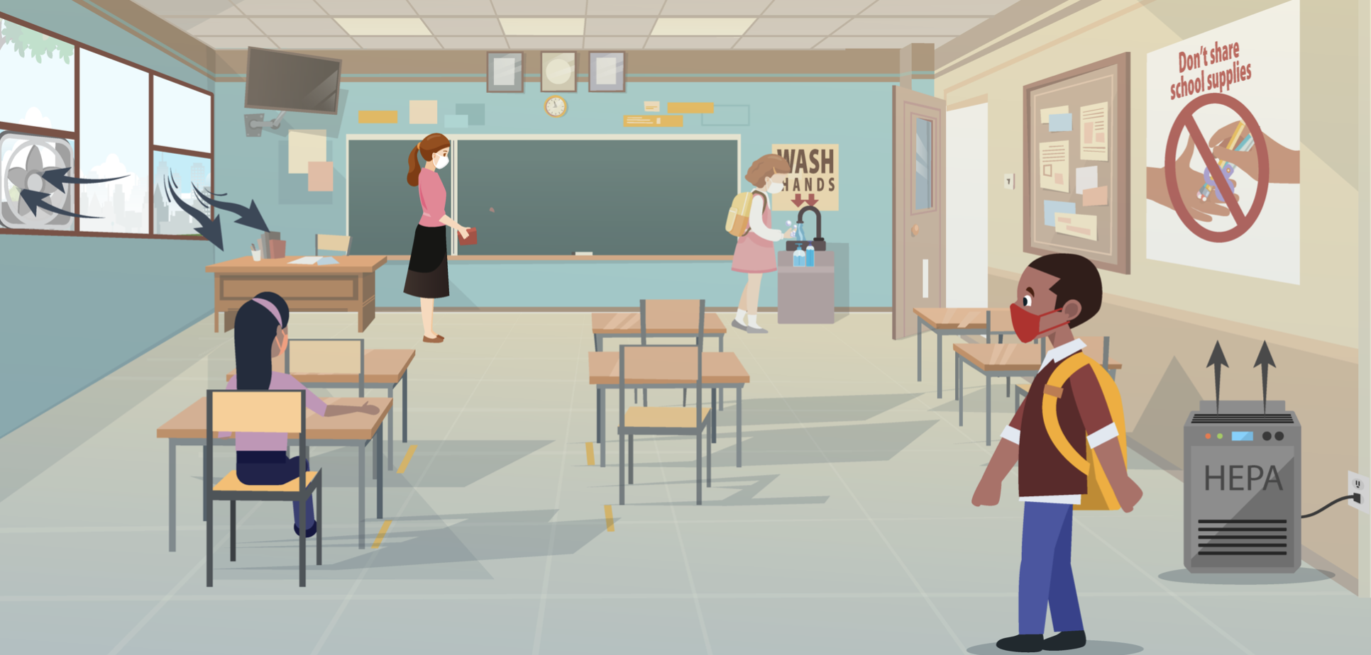
Health and Safety Information
Site Safety and Preparation
Air flow and ventilation (fresh air)
Windows/doors open
Vents open
Continuous air flow
HEPA Units
Highest rated filters (Merv-13)
CDC recommendations
returntogether.scusd.edu
Notes:
While there are no outlined requirements for ventilation, the recommendation and accepted practice is to create as much air flow as possible. This picture from the CDC mirrors what a SCHOOL classroom will look like when it comes to ventilation and air flow.
Classroom windows and doors will be open, as much as possible. Our site has also adjusted all vents to allow in more outside air. This creates the same effect of as a whole house fan, with flows of outside air. We will also run our units constantly to continuously circulate fresh outside air. Additionally, we have installed MERV 13 filters in as many units as possible and will place a hospital grade HEPA unit in each classroom.

Slide 34
Health and Safety Information
What happens if there is a COVID case on campus?
SCUSD has a detailed process for notifying anyone who was potentially exposed.
If a cohort was exposed:
  Families notified, contact tracing conducted
  Students and staff would quarantine for 10 days/Distant Learning
  Participate in distance learning
  COVID testing will be offered for all exposed individuals
returntogether.scusd.edu

Slide 35
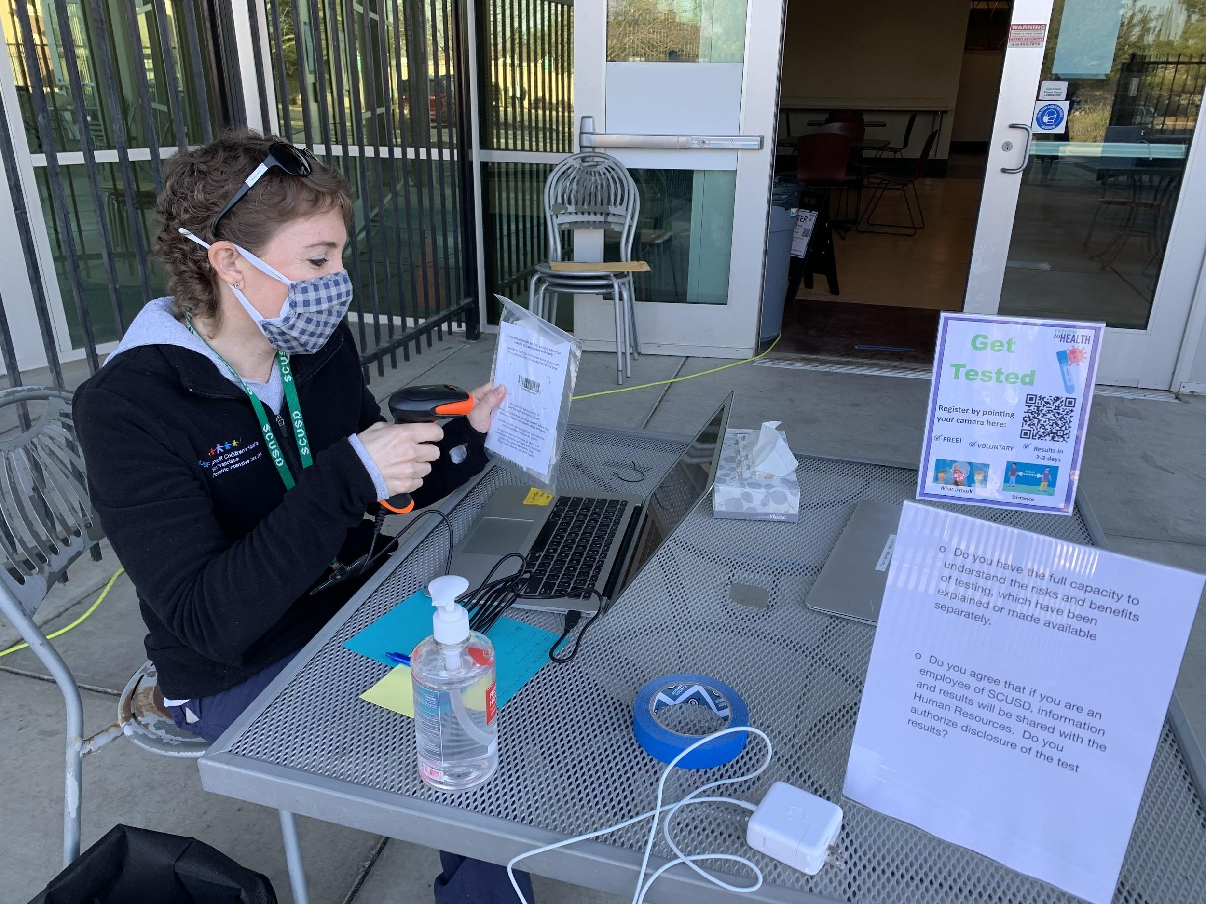
Health and Safety Information
COVID-19 Testing
Our district will offer two types of tests (rapid response and asymptomatic surveillance testing) during the school day.
Tests are self administered and voluntary.
In our current tier:
SCUSD must offer rapid response testing.
SCUSD must offer opportunities for testing every two weeks.
returntogether.scusd.edu
Notes:
Parents, we will be sending out information about how to register your students for testing at school sites.
Testing is free and voluntary but we encourage everyone to participate.
Our district will offer two types of tests (rapid response and asymptomatic surveillance testing) during the school day.
SCUSD is utilizing two types of COVID tests. Both tests are self-administered nasal swabs, which means individuals use a long soft cotton swab to gently circulate in each nostril.
PCR Testing is widely used and known as the most reliable test. Results are provided within 24-48 hours.
Rapid antigen tests/BinaxNOW provides results within 15 minutes, however any positive test results must be confirmed with a PCR test. If used for surveillance screening, the rapid antigen test must be administered twice weekly while daily case rates are greater than 14 per 100 thousand individual
Tests are self administered, which means that we provide instruction for students to test themselves. This makes the process less intimidating.
Please look out for information for our school site testing event.

Slide 36
Health and Safety Information
Vaccinations
In addition to hosting vaccination clinics on site, our district has invited all staff to receive the vaccine.
There is not currently a vaccine approved for children under 16.
We recommend everyone eligible to get the vaccine. It is safe and healthy, and one of our best lines of defense!
returntogether.scusd.edu

Slide 37
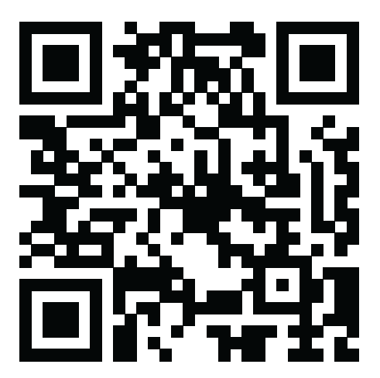
Recap
Complete the Learning Options Form by March 17 to tell our district whether your student will participate in-person or in distance learning.
Complete the form at k12-schedule.com/sac-city
One form per student.
Student ID number is required.
The number may be found in Infinite Campus.
You might have also received text message with the ID number.

Slide 38
Recap
Schools are scheduled to reopen:
  April 8 (Ek-3, Special Day Classes); April 15 (4-6);
If in red: May 6, (7-12)
We will offer two learning models: In-person/concurrent and distance learning
Families must decide their learning option by March 17
Strict Health and Safety protocols in place
Questions?
returntogether.scusd.edu
Notes:
Site: If you have a Learning Hub, please add this to the slide to remind families they will continue.

Slide 39

Questions
Questions

